Slide 1


Chapter 6
Multimedia Computing
Bin Shi
Xian Jiaotong University
2021-12-13

Slide 2

Introduction
In general, multimedia could be defined as the usage of multiple agent (text, audio, video, images) for disseminating and presenting information to audience (target user).
Multi :“numerous, multiple”
Media : Used for dissemination (distribute) and representation of information.
Notes:
Multimedia是用多种代理（介质）来传播与表示多种信息（听觉，视觉，触觉，嗅觉信息等），如图像，音频，视频，传感器等。
Multi 表示多种
Media 表示承载信息的介质

Slide 3


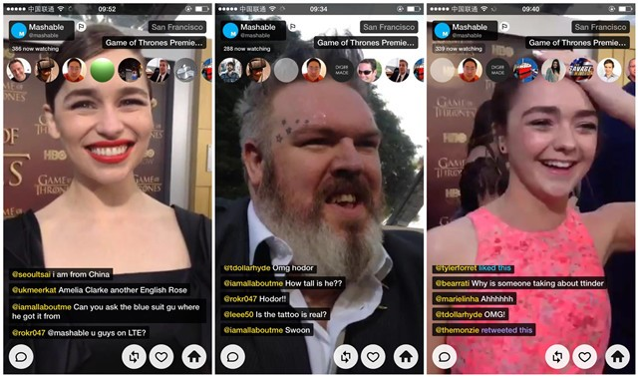


Introduction
Multimedia is a combination of a variety of mechanisms to convey information.
Multimedia is important, e.g.:
Education
Entertainment
Communication
Online Course
Movie
Video Conference
Notes:
简单而言，多媒体是用来传递信息的多种手段的集合
被广泛用于学习、娱乐和通信。
因此，多媒体技术及其应用，是计算机领域的一类重要基础技术和应用

Slide 4
Contents
Some basic knowledge of multimedia including：
Representation: Audio, Image, Video
Codec
Search
Delivery
And, examples of multimedia applications.
Notes:
本堂课的内容包括两大部分
第一部分是多媒体技术相关的基本知识
第二部分是一些典型的多媒体应用

Slide 5
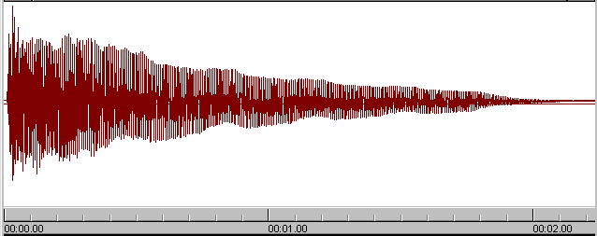

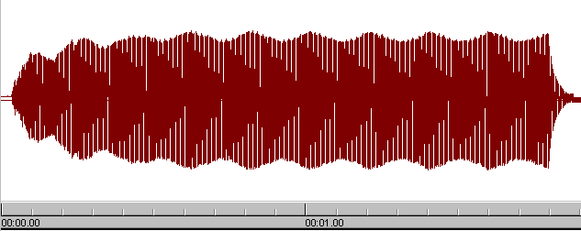
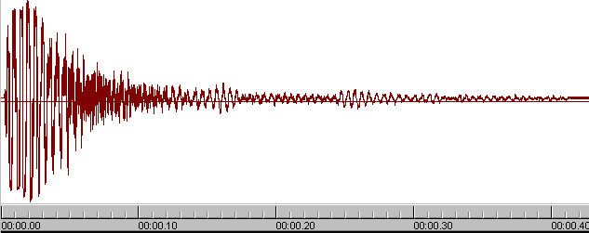
1
Representation
PART
PART
PART
Audio
A vibration that propagates as a typically audible mechanical wave of pressure and displacement, through a medium such as air or water.
Piano
Pan flute
Snare drum
Notes:
声音是自然界中的一种压力波
不同乐器产生的声波的频率不同
下面的例子是
钢琴
排萧
小军鼓

Slide 6
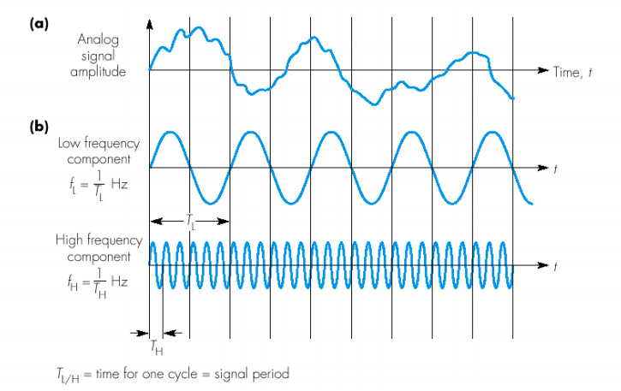
1
Representation
PART
PART
PART
Analog signal: Sight and sound we perceive in our natural world are continuous.
Continuous and infinite number of points between any two points.
Notes:
自然界中，视觉、听觉等模拟信号是连续的

Slide 7
1
Representation
PART
PART
PART
Issue: natural medias are analog continuous signals, however, computers handle discrete digital data only, therefore, how to realize analog-to-digital conversion is a fundamental issue to represent multimedia information on computer.
Method: Sampling and Quantization.
Notes:
计算机中，智能处理数字信号，是用0和1表示的离散信号

Slide 8
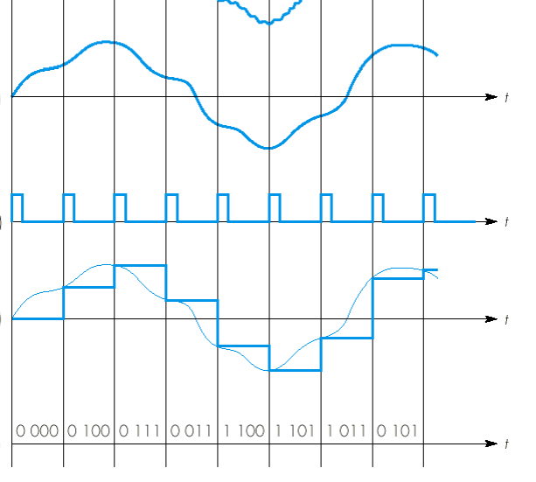
1
Representation
PART
PART
PART
Step1. Sampling:
Obtain the corresponding amplitude value in fixed sampling time interval.
Step2. Quantization:
Confines the amplitude of a signal into a finite number of values.
Notes:
抽样和量化
将连续的模拟信号转换为离散的数字信号
抽样的频率决定了抽样结果的准确性

Slide 9
1
Representation
PART
PART
PART
Capture and playback of digital audio
Air pressure
variations
Digital to
Analogue
Converter
Convert back into voltage
DAC
Captured via
microphone
Analogue
to Digital
Converter
ADC
0101001101
0110101111
Air pressure
variations
Notes:
通过麦克风设备，捕获声音造成的压强变化
通过变换将连续信号转换为离散信号进行存储
播放时，是相反的步骤
将离散信号转换为连续信号，通过音箱改变压强，进而产生声波的变化

Slide 10
1
Representation
PART
PART
PART
Image---A group of pixels.
All images are displayed in the form of a two-dimensional matrix of individual picture elements called pixels.
Notes:
图片是由像素构成的

Slide 11
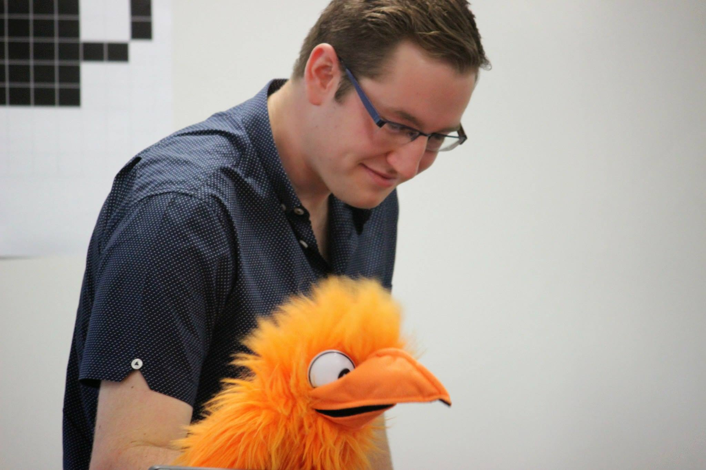


1
Representation
PART
PART
PART
Image---Pixel
This photo looks like contains smooth variations in shading, but…
1
2
…and we zoom in even more, we can see that the image is made up of lots of small squares, so called pixels.
…if we zoom in on his eye, we can see that it is not completely smooth…
3
Notes:
当把图像放大时，可以看到图像是由小块构成的
构成图像的最小块 就是像素
人眼：五亿七千六百万

Slide 12
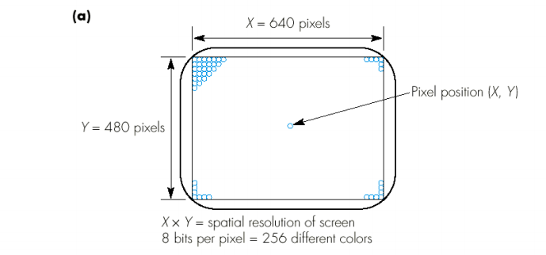
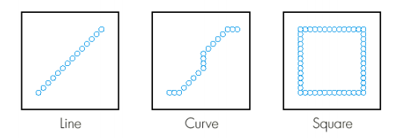
1
Representation
PART
PART
PART
Image---Pixel
Notes:
一个像素可用8个字节表示，8个字节可以表示256种不同的颜色

Slide 13
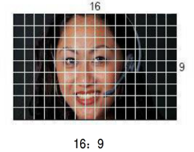
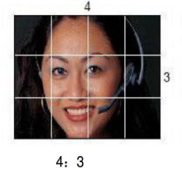
1
Representation
PART
PART
PART
Image---Aspect ratio
Aspect ratio of image describes the proportional relationship between its width and its height.
Common standards
4:3 used in classic TV
16:9 used in widescreen television
Notes:
帧的宽高比描述了画面的宽度与高度之间的关系。
常见的宽高比有：4:3，常见于传统电视中，如右上角的图所示，宽高比为4:3
常用的宽高比还有 16:9 常用于现在的宽屏高清电视中，如下面这张图所示，宽高比为16:9

Slide 14
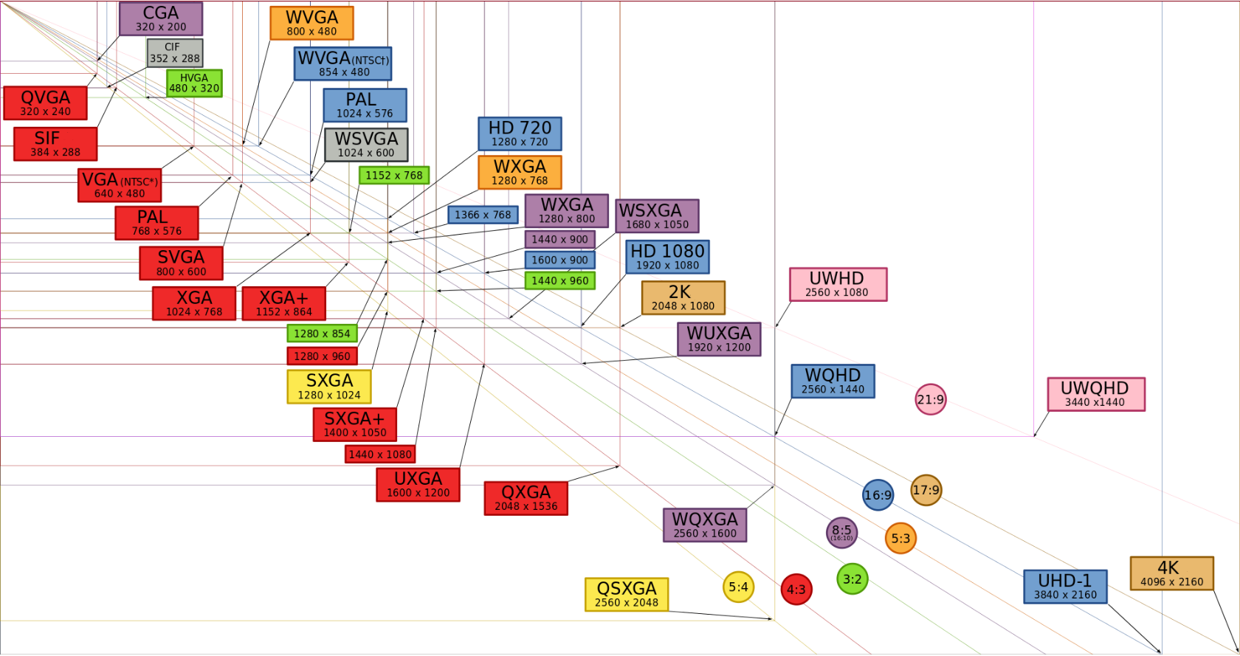
1
Representation
PART
PART
PART
Image---Resolution
Display Resolution
Notes:
分辨率
X轴和Y轴的像素数
目前处于高清1080P和4k的时代
1920*1080
4096*2160

Slide 15
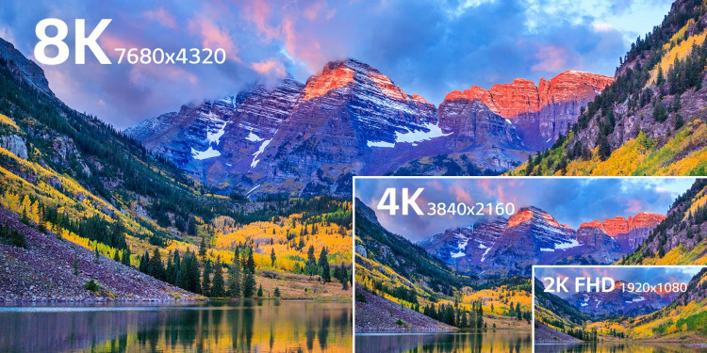
1
Representation
PART
PART
PART
Image---Resolution
Display Resolution
Notes:
在4k分辨率的基础上，出现了8K分辨率的图像和视频
像素数和面积 是2K 1080P的16倍

Slide 16
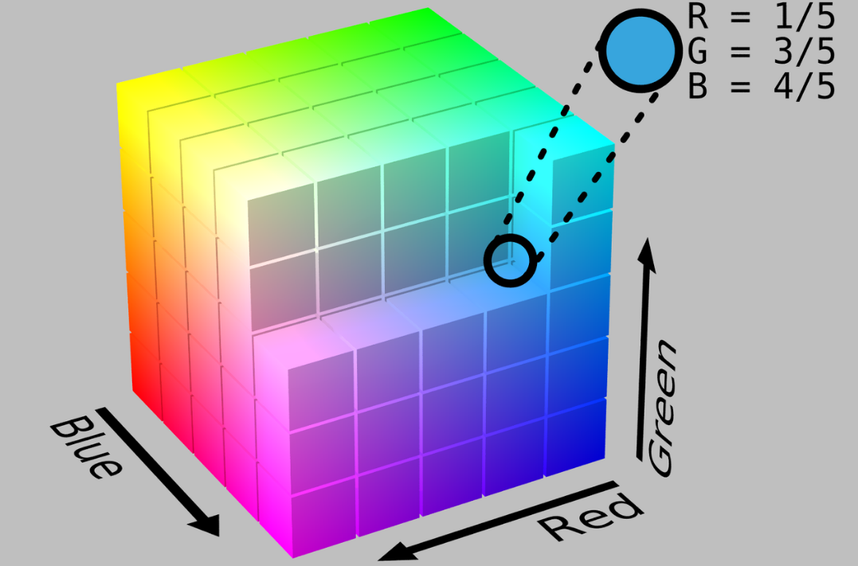
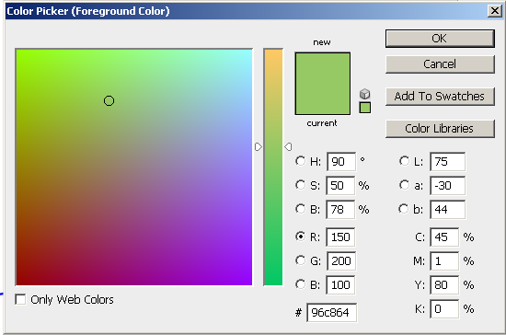
1
Representation
PART
PART
PART
Each pixel has color. RGB、YUV、CMYK、HSB、CIE and their variants are common color models.
RGB color space is defined by the three chromaticity of the red, green, and blue, and can produce any chromaticity that is the triangle defined by those primary colors.
RGB Color
Color Picker
Notes:
颜色空间
每个像素是有颜色的
如果一个像素用8位表示，可以包含256种颜色
随堂作业，就是

Slide 17
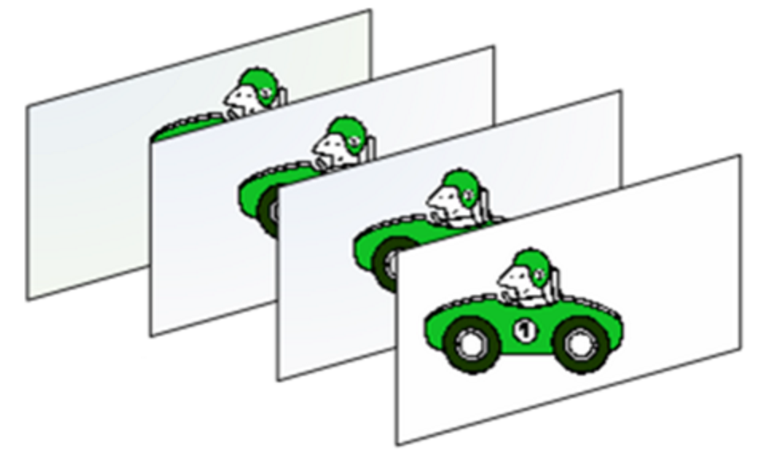
1
Representation
PART
PART
PART
Video: a group of images. Video combines a sequence of images to form a moving picture. It usually has audio components that correspond with the picture being shown on the screen.
One Frame
Notes:
介绍视频的基本概念：
视频是通过对一组图片进行快速的播放而生成的。在视频中，当图像展示在屏幕上时通常伴有声音的出现。
在视频中，被快速播放的画面被称为视频帧。一张图片称为一帧。

Slide 18
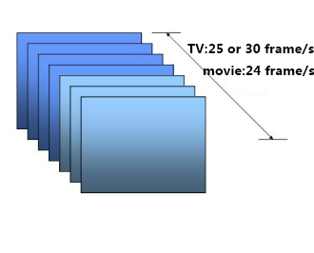
1
Representation
PART
PART
PART
Video--- Frame rate
Frame rate is the frequency at which an imaging device displays consecutive images called frames.
Frame rate should be higher than 15frame/s . Why ???
Persistence of vision works because the human eye and brain can only process 10 to 12 separate images per second, retaining an image for up to 15 of a second. If a subsequent image replaces it in this period of time it will create the illusion of continuity.
TV: 30 or 25 frames/s Movie: 24 frames/s
Notes:
帧率是视频设备播放连续图像（在视频中被称为帧）的频率
一般来说，帧率应该要达到15帧以上，关键就是因为我们人眼自身的结构造成的视觉停留
视觉停留的意思是说当一个图像消失之后还会在视网膜上停留 1/15s的时间，因此当帧率小于15的时候我们的人眼就能区分出这是一张张的图片，大于15的时候由于视觉停留，我们的人眼感知到的就不在是静止的图片而是动画；
右下角的这张图表示了常见的帧率，在电视中常见的帧率是25或者30 ，在电影中常见的24

Slide 19
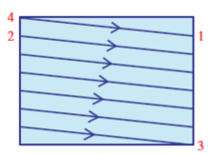
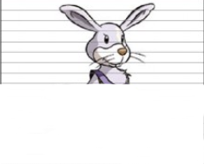
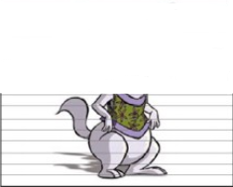
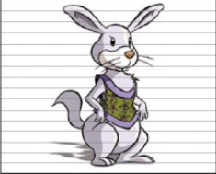
1
Representation
PART
PART
PART
Video--- Scanning characteristic
Progressive video scanning
At the end of a scan (1), the electron gun spot snaps back to (2).
After reaching the end of a frame (3), the spot snaps back to (4).
Notes:
视频显示在屏幕上有两种基本的方式，一个是逐行扫描，一个是隔行扫描
逐行扫描是将每帧的画面同时显示，举个例子来说，如图所示
当扫描到1结束的时候，接下来还返回到2这个点来继续扫描；
当扫描到3，整个帧扫描结束之后，会从4起点重新下一帧的扫描

Slide 20
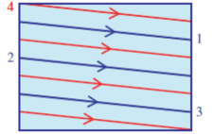
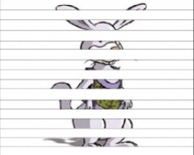
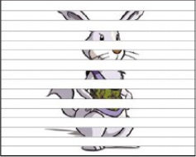
1
Representation
PART
PART
PART
Video--- Scanning characteristic
Interlaced video scanning
Red and blue fields are alternately scanned left-to-right and top-to-bottom.
At the end of scan (1), the spot snaps to (2).
At the end of the blue field (3), the spot snaps to (4) (new field).
Notes:
隔行扫描是每一帧被分割为两场，每一场包含了一帧中所有的奇数扫描行或者偶数扫描行，通常是先扫描奇数行得到第一场，然后扫描偶数行得到第二场。举个例子来说，如图所示
红色与蓝色的区域是交替被扫描的；
当扫描到蓝色的1结束的时候，接下来会隔行到蓝色的2这个点来继续扫描；
当扫描到红色3结束之后，即奇数行被扫描完成之后会开始扫描偶数行，会从4开始进行偶数行的扫描
最下面的图像是个具体的例子，先进行奇数行的扫描再进行偶数行的扫描，最后得到整个帧的图像

Slide 21
1
Representation
PART
PART
PART
Video--- Scanning characteristic
Progressive scanning vs Interlaced scanning
 | Progressive video scanning | Interlaced video scanning
Scope | HD 、 video capture card | early television
Advantage | getting the high quality of image | improveing the channel utilization
Disadvantage | needing more bandwidth | interline flicker effect 、 vertical edge aliasing
Notes:
隔行扫描与逐行扫描的比较。
早期的电视制式均采用隔行扫描，但是现在很多的高清、视频采集卡都是采用逐行扫描模式
隔行扫描后提高了信道利用率，会产生行间闪烁效应以及出现垂直边沿锯齿化现象等
逐行扫描可以得到高品质的图像质量，但同时也需要更多的带宽

Slide 22
1
Representation
PART
PART
PART
The advantages of digital representation for multimedia data are many, e.g.:
Data can be stored on digital devices or in memory, which is convenient to organize and archive.
Direct access is possible, which makes nonlinear video editing achievable as a simple, rather than a complex, task.
Repeated recording does not degrade image quality.
Notes:
从存储、访问和分发的角度 介绍了数字化方式表示多媒体的优势

Slide 23
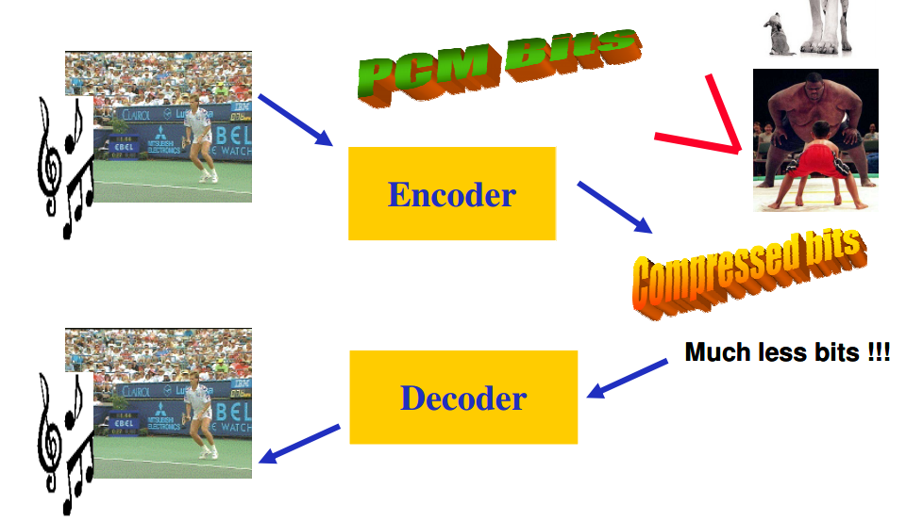
2
Codec
PART
PART
PART
Codec is a device or computer program for encoding or decoding a digital data stream or signal.
In other words, compressor-decompressor.
Maximizing the quality for the available rate.
Minimizing the rate for a target quality.
Compression
Notes:
编解码
其实质是对多媒体内容进行压缩和解压缩
以便于数据的存储和分发

Slide 24
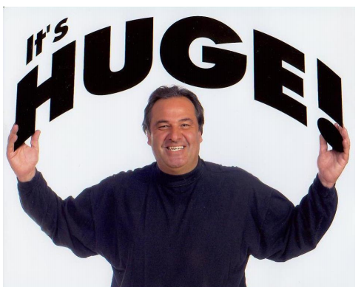
2
Codec
PART
PART
PART
Compression is necessary.
Size of 1min video file
Frame Rate | Frame Size | Bits per Pixel | Bit Rate (bps) | File Size (Byte)
25 | 1920*1080 | 12 | 622M | 4.66G
Notes:
压缩是有必要的
1分钟视频的原始码率达到了622Mbps，文件大小为37.3GB
如果不压缩，很难存储和传输
25*1920*1080*12
622*60

Slide 25
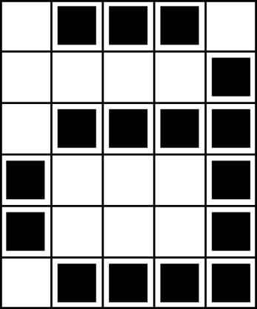

2
Codec
PART
PART
PART
Compression is possible.
For an image, adjacent pixels are correlated.
0, 1, 1, 1, 0
0, 0, 0, 0, 1
0, 1, 1, 1, 1
1, 0, 0, 0, 1
1, 0, 0, 0, 1
0, 1, 1, 1, 1
No Compression
(0=white 1=black)
1, 3, 1
4, 1
1, 4
0, 1, 3, 1
0, 1, 3, 1
1, 4
Compressed
(Start with white)
Notes:
对于图像来说
压缩是可行的
图像中相邻像素是具有一定的相关性

Slide 26
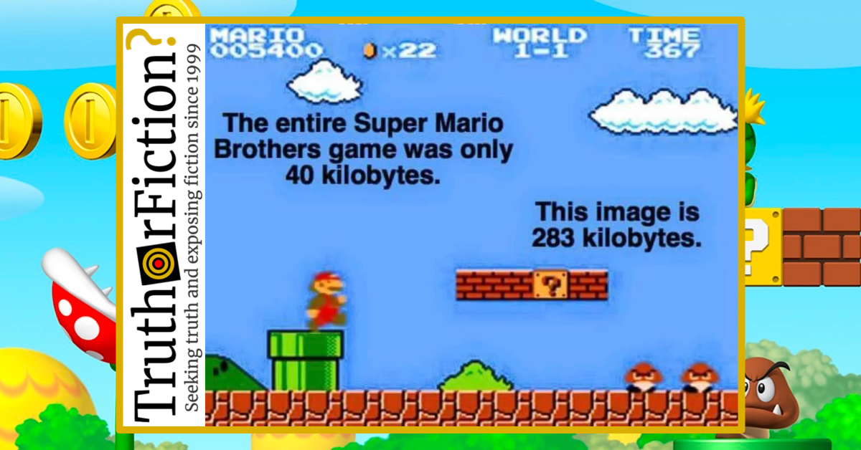
Super Mario examples

Slide 27
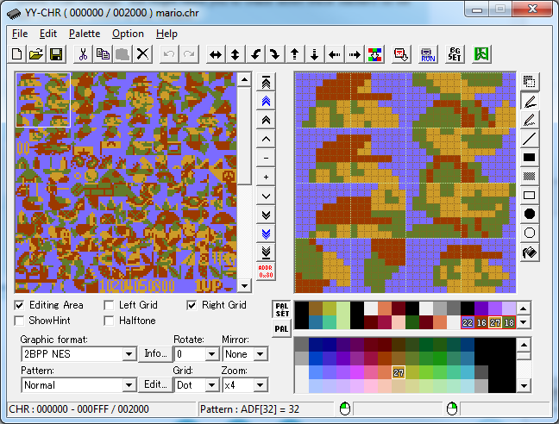
2
Codec
PART
PART
PART
Compression is possible.
In an image, some patterns are the same .
Notes:
对于图像来说
压缩是可行的
图像中相邻像素是具有一定的相关性
8*8*8=用256就表示了，节约了64倍的空间。

Slide 28
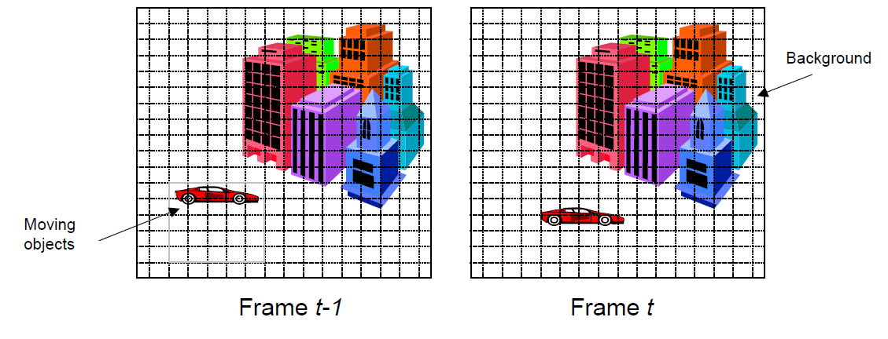
2
Codec
PART
PART
PART
Compression is possible.
For a video, adjacent frames are correlated.
Temporal Correlation
Notes:
对于视频来说，压缩是可能的
相邻视频帧之间，具有时间相关性

Slide 29
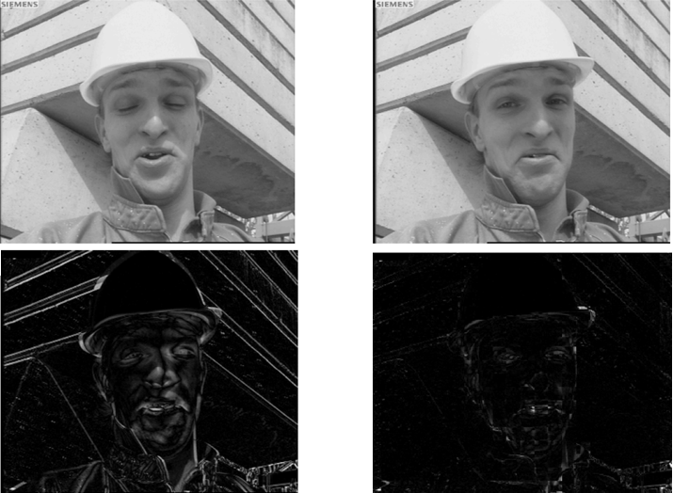
2
Codec
PART
PART
PART
Compression is possible.
For a video, adjacent frames are correlated.
Differences of
Fame t and Frame t-1
Frame t
Frame t-1
Notes:
因此，对于视频来说
只需要存储两帧之间的差异，
可以减少文件大小，降低码率

Slide 30
2
Codec
PART
PART
PART
Compression is possible.
MPEG output consists of three kinds of frames:
I- (Intracoded) : Self-contained compressed still pictures.
P- (Predictive) : Block-by-block differences with previous frames.
B- (Bidirectional) : Block-by-block differences between previous and future frames.
Notes:
MPEG（Moving Picture Experts Group，动态图像专家组）
将视频帧分为了 I B P三种不同的类型

Slide 31
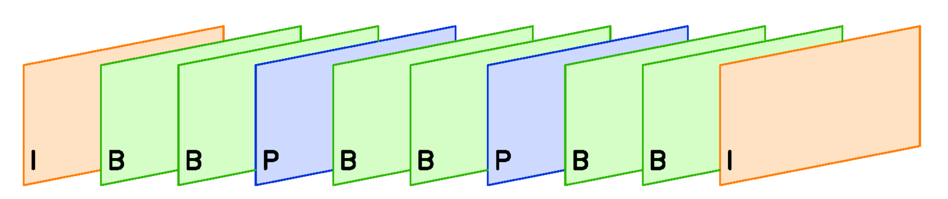
2
Codec
PART
PART
PART
Compression is possible.
Time
I‑frames are the least compressed but don't require other frames to decode.
Notes:
I帧（关键帧）压缩率最低，但是它可以独立解码，不依赖于别的帧

Slide 32
2
Codec
PART
PART
PART
Compression is possible.
Time
P‑frames can use data from previous frames to decode and are more compressible than I‑frames.
Notes:
P帧压缩率较高，但是它的解码依赖于前面的帧

Slide 33
2
Codec
PART
PART
PART
Compression is possible.
Time
B‑frames can use both previous and forward frames for data reference to get the highest compression.
Notes:
B帧压缩率最高，但是它的解码依赖于前面的帧与后面的帧
B帧一般为前面帧（P/I），后面帧（P）的逐块差值
I的压缩率是7（跟JPG差不多），P是20，B可以达到50
B帧以前面的I或P帧和后面的P帧为参考帧,“找出”B帧“某点”的预测值和两个运动矢量,并取预测差值和运动矢量传送。接收端根据运动矢量在两个参考帧中“找出(算出)”预测值并与差值求和,得到B帧“某点”样值,从而可得到完整的B帧。

Slide 34
2
Codec
PART
PART
PART
Common codec standards
ITU-T
Standards
H.261
H.263
H.263+
H.263++
Joint
ITU-T/MPEG
Standards
H.262/
MPEG-2
H.264/AVC
H.264/SVC
H.265/HEVC
MPEG
Standards
MPEG-1
MPEG-4
MPEG-21
MPEG-H
MPEG-
DASH
MPEG-
IoMT
1995
2005
2015
2020
Smaller, Better and Faster
Notes:
国际电信联盟
国际标准化组织和国际电工委员会
图中是主流的编解码算法
目前主流是H.264，正逐渐被H.265代替

Slide 35
3
Search
PART
PART
PART
External characteristics based
Text description based
Content based
Notes:
三类检索
特征，如文件名称，文件类型等
描述，如视频内容的文本描述
内容：原始内容，非标注内容或者特征
前两类基于元数据标注
后一类基于原始内容

Slide 36
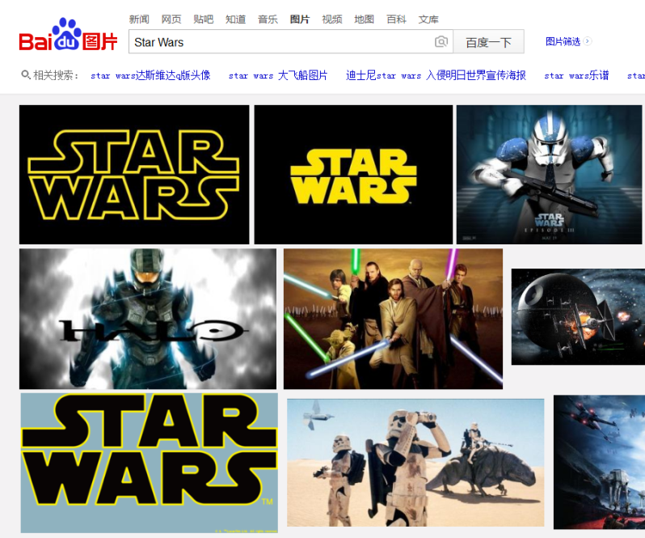
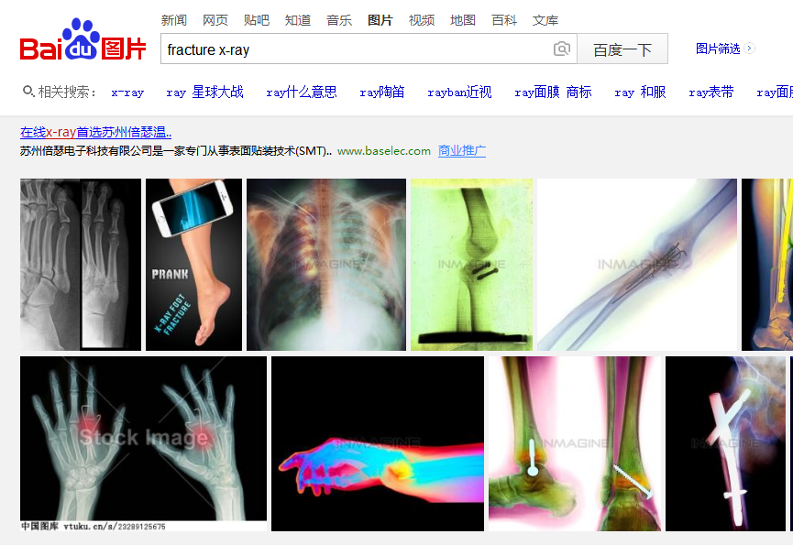
3
Search
PART
PART
PART
External characteristics
Filename, format, title, etc.
Text description
The contents of the multimedia data in words.
By title
By description
Metadata Searching
Notes:
特征描述法，以视频文件的外部特征进行检索，如文件名、标题、文件类型等
文本描述法利用自然语言的优势，将图像、声 音等多媒体信息的内容用文字进行确切的描述，揭示其内在的各种语义联系，形成描述性的自由文本。
如 电影名称，医学行为描述
这两种方法都是基于元数据的检索

Slide 37
3
Search
PART
PART
PART
Metadata: Data about the Data
Describe the data/content itself, e.g. doc.
Describe the data/content coding format, coded quality, etc.
Describe the data/content category, e.g. sport.
……
Notes:
元数据：用来从不同角度描述数据的数据
文件类型 如doc
编解类型，质量等 如mp4，高清
数据内容的分类，例如体育类

Slide 38
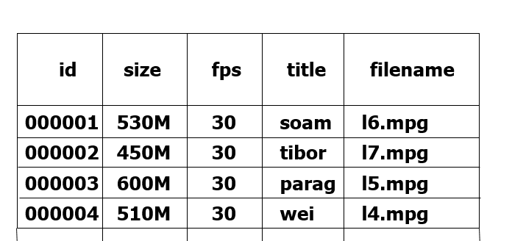
3
Search
PART
PART
PART
Process of metadata based search
Metadata
select * from table where title =‘tibor’
The more it is known about the data (metadata), the better the data can be searched.
Notes:
基于元数据的检索
当元数据信息越丰富的时候
越容易检索到想要的内容
通过sql进行

Slide 39
3
Search
PART
PART
PART
External characteristics based
Filename, format, title, etc.
Text description based
Described the contents of the multimedia data in words
Shortage
The content in multimedia data is rich.
The description is subjective.
Fuzzy query.
Metadata Searching
Notes:
问题在于：
1、视频内容很丰富
2、对视频的描述和对需要内容的描述主观性很强
3、基于文本描述的查找涉及到模糊查找

Slide 40
3
Search
PART
PART
PART
External characteristics based
Text description based
Content based
Known as Content-based Visual Information Retrieval.
The search engine analyzes the contents of the data rather than the metadata.
Notes:
基于内容语义的检索
搜索引擎分析多媒体数据本身所包含的内容和语义，
而不是对描述多媒体内容进行描述的元数据进行分析

Slide 41
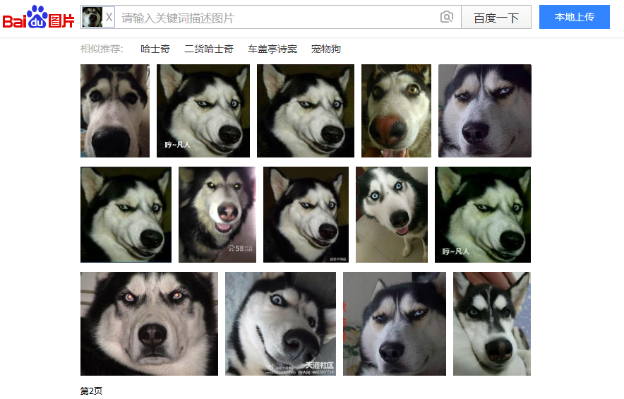
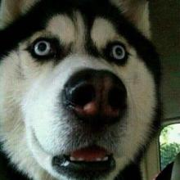
3
Search
PART
PART
PART
Content based-Searching an image by image
Pic as input
Notes:
以图片搜索相似的图片

Slide 42
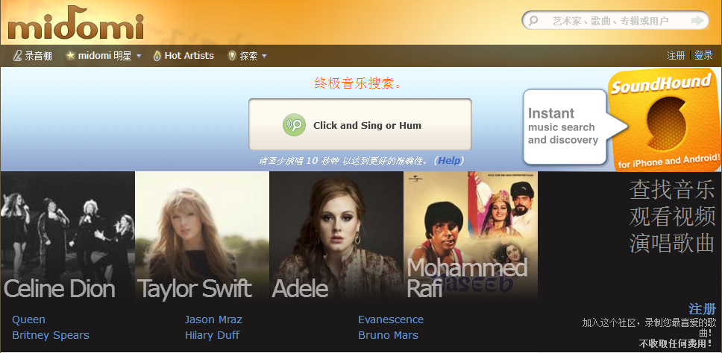
3
Search
PART
PART
PART
Content based-Searching a music by theme
sol – sol –sol – mi – fa – fa – fa -re
Melody as input
Notes:
哼歌搜歌

Slide 43
3
Search
PART
PART
PART
Process of content based search
Notes:
首先分析多媒体对象的内容，提取特征和语义，将这些特征语义生成特征向量或者字符串，匹配数据库中已经存储的向量或字符串，再根据索引找到对应的多媒体文件。
举例：比如输入一段声音，分帧后提取它的音高和旋律等声学特征，形成向量矩阵（图中就是一个向量矩阵，也称之为观察序列，每一帧都有一个n维（n由声学特征个数决定）向量，色块的颜色深浅表示向量值的大小），然后将矩阵转换为文本（此处为重点和难点，涉及声学模型，参数训练，构建状态网络及路径匹配等问题）。
关于向量到文本的转换：每个竖条代表一帧，若干帧对应一个状态，每三个状态对应一个音素（可看作声学单位），若干个音素对应一个单词。通过这个过程，将一系列的帧数据转换为文本形式。

Slide 44
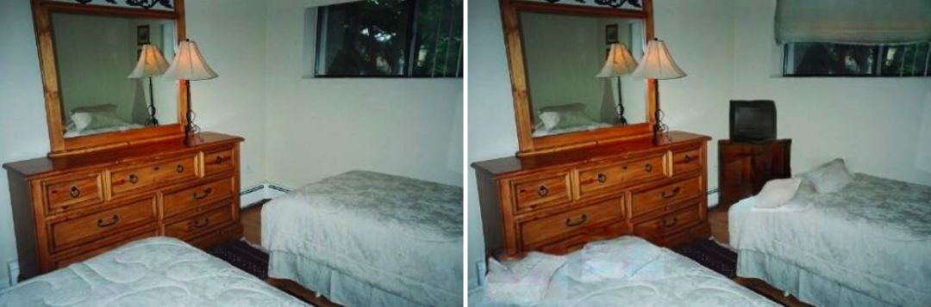
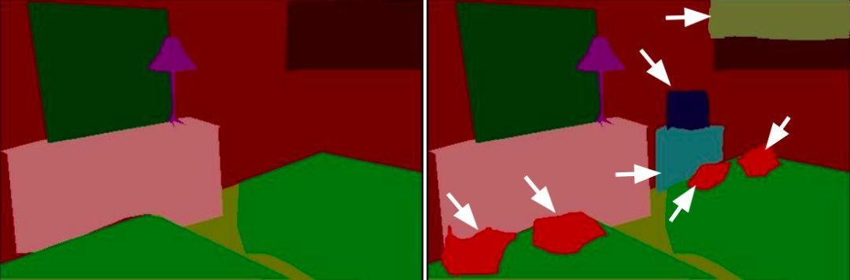
3
Search
PART
PART
PART
Notes:
理解多媒体数据的语义，涉及图像识别等计算机视觉技术
例如，从图像中识别出物体的边缘，进一步识别出物体的类型
然后可以做进一步的处理，比如可以增加一些物品、广告而不显得违和

Slide 45
4
Delivery
PART
PART
PART
To get multimedia data (Video):
The download mode
A user downloads the entire video file and then plays back the video file.
The streaming mode
The video content need not be downloaded in full, but is being played out while parts of the content are being received and decoded.
Notes:
多媒体传输，以视频为例
文件下载方式，下载完才能播放
渐进下载方式（流式），边下边播

Slide 46

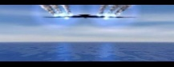
4
Delivery
PART
PART
PART
Video Streaming
1. Client play out begins before all data has arrived: timing constraint.
3. How to improve better quality? e.g., less stalling.
2. Internet is a best-effort service with no guarantees on delay and loss.
Notes:
互联网是尽力而为的网络
如何保证视频传输的质量？

Slide 47
4
Delivery
PART
PART
PART
Quality1: Quality of Service (QoS)
The overall performance of the network to guarantee delivering predictable results.
Value of the average service richness estimated by a service/product/content provider.
Quantifiable parameters: error rates, bit rate, throughput, transmission delay, jitter, etc.
Notes:
定义传输质量的有两个标准，QoS和QoE。
QOS是对整个网络性能的一个评价，体现了服务提供者从服务、产品、内容的平均服务质量，这个指标偏客观。具体的指标参数有数据包错误率，发送的码率，吞吐率，传输延时，抖动等。

Slide 48
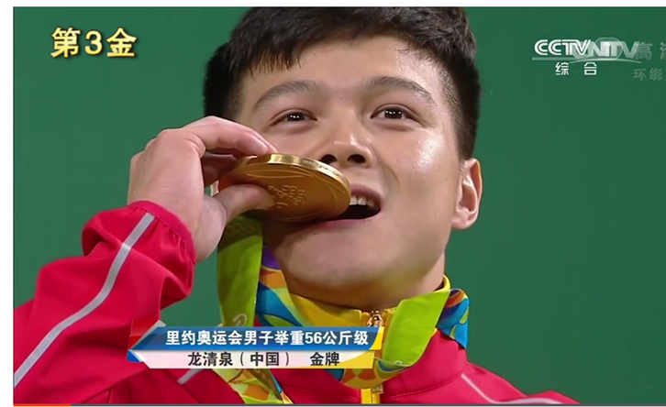
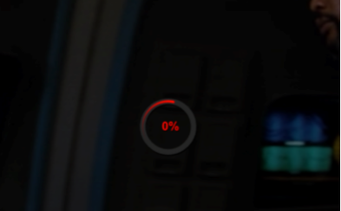

4
Delivery
PART
PART
PART
Quality2: Quality of Experience (QoE)
The degree of richness of the (individual) experience recognizing the central role of the user.
The subjective experience of user is quantified by Mean Opinion Score.
Good(85)
Poor(70)
Bad(60)
Notes:
QoE主要从用户角度出发，是用户认为这个视频的质量状况，偏主观的。当出现卡顿，视频卡顿和低码率时就认为QOE很差的状况。

Slide 49

4
Delivery
PART
PART
PART
Internet is a best-effort service.
Network Loss: datagram lost due to network congestion.
router buffer overflow
constant bit rate
transmission
client
reception
constant bit
rate playout
at client
Cumulative data
variable
network
Delay
(Jitter)
loss
buffered
data
client playout
delay
time
Notes:
数据包由于网络中拥塞等原因，未到达播放器，丢失

Slide 50
4
Delivery
PART
PART
PART
Internet is a best-effort service.
Delay Loss: datagram arrives too late for playout at receiver.
processing, queuing in network; end-system delays
constant bit
rate
transmission
client
reception
constant bit
rate playout
at client
Cumulative data
variable
network
Delay
(Jitter)
buffered
data
loss
client playout
delay
time
Delay Sensitive
Notes:
数据包由于延迟到达，晚于播放时间到达播放器，认为属于丢失

Slide 51
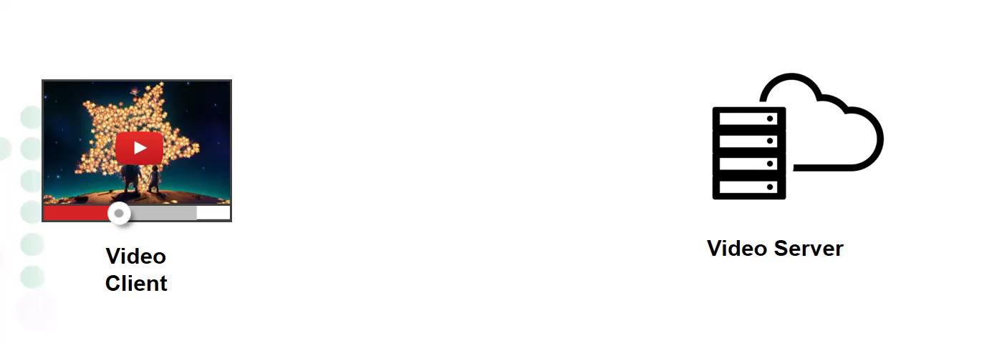
4
Delivery
PART
PART
PART
Internet is a best-effort service.
reBuffering---player buffer underflow when the video bitrate exceeds the network capacity.
Animation borrowed from Te-Yuan Huang (SIGCOMM ‘14) http://conferences.sigcomm.org/sigcomm/2014/doc/slides/38.pdf
Notes:
网络性能的不稳定，产生数据丢失时，会造成视频播放的卡顿
播放器向服务器端请求媒体数据
服务器端返回的数据放入播放缓冲区中
播放器消耗数据，服务器填入数据
当消耗的速度大于填入的速度时，缓冲区下溢出，造成播放器的视频内容无法正常播放而出现卡顿
主要原因是视频的码率大于网络的能力

Slide 52
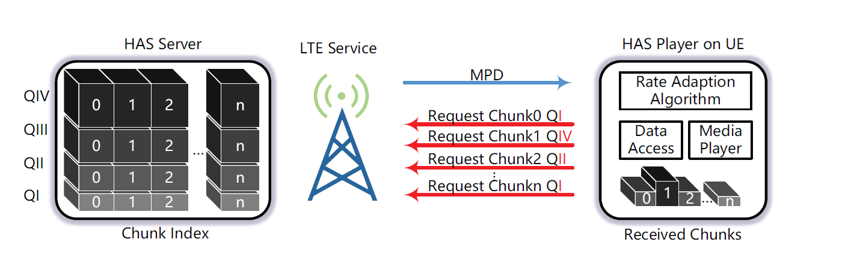
4
Delivery
PART
PART
PART
Improving Quality
Rate Control---Adaptive Bitrate (ABR)
To make balance between maximize Video Quality and minimize reBuffering time，which is Conflicting.
The key is to determine the bitrate of video chunks based on the estimated network capacity.
HTTP Adaptive Streaming（HAS）
A Survey on Bitrate Adaptation Schemes for Streaming Media over HTTP，IEEE Communications Surveys & Tutorials 2016
Notes:
提高质量的两种方法
速率控制，使得发送速率与网络带宽相匹配
这种技术被称为HTTP码率自适应技术（HAS）
其核心在于如何评估带宽以及如何调整速率
一些当前研究进展综述，可以参考这篇文章

Slide 53
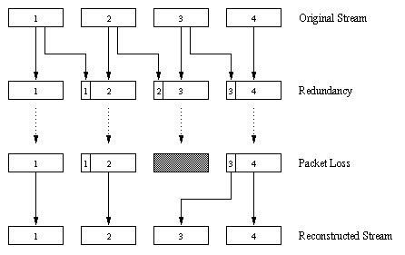
4
Delivery
PART
PART
PART
Improving Quality
Error Control---Error recovery: the central idea is the sender encodes the message in a redundant way. e.g., Forward Error Correction (FEC)
For every group of n chunks create a redundant chunk by exclusive OR-ing the n original chunks.
Send out n+1 chunks, increasing the bandwidth by factor 1/n.
Can reconstruct the original n chunks if there is at most 1 lost chunk from the n+1 chunks.
Notes:
FEC算法
增加数据的冗余，
使得当出现数据丢失时，
能够从冗余数据中进行恢复

Slide 54
4
Delivery
PART
PART
PART
Improving Quality
Error Control---Error reliance: when the lost is non recoverable, to reconstruct the lost data from data in the previous or neighboring frames. e.g.，Frame copy.
2
Notes:
当数据无法恢复时
通过利用相邻数据帧的信息对丢失数据帧进行重构
例如插入相同的数据帧
降低丢失对视频质量的影响

Slide 55
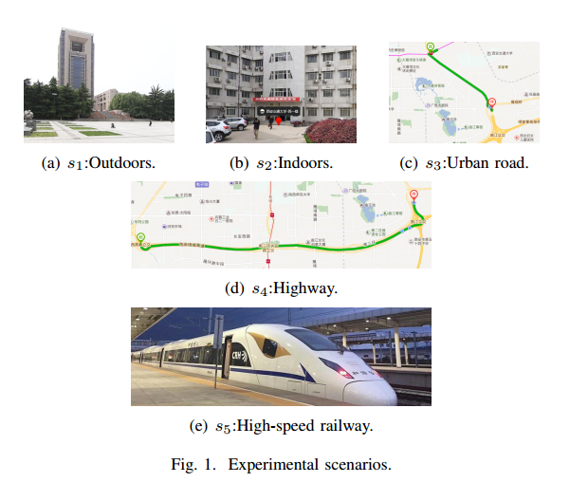
4
Delivery
PART
PART
PART
Challenge in mobile environment
Rule based algorithms
Simplified or inaccurate models of the deployment environment.
Fail to achieve optimal performance across a broad set of network conditions.
Notes:
已有的研究虽然都有着不错的表现，但是，他们都有相同的缺点，即都需要对网络进行建模。
这就导致了上面提到的方法都会存在很多不足之处，第一点是方法并不具有普适性。其次，建模本身就是一个简化的过程，这种简化下的解大多数情况下得到的都是次优解。
例如移动网络，在用户终端设备处于不同的环境或者场景中时，网络带宽的变化特征相差很大，基于规则的方法很难以得到最优解。

Slide 56
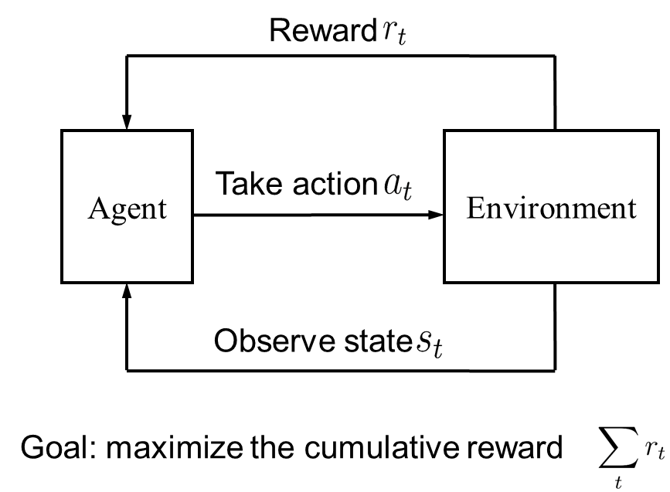
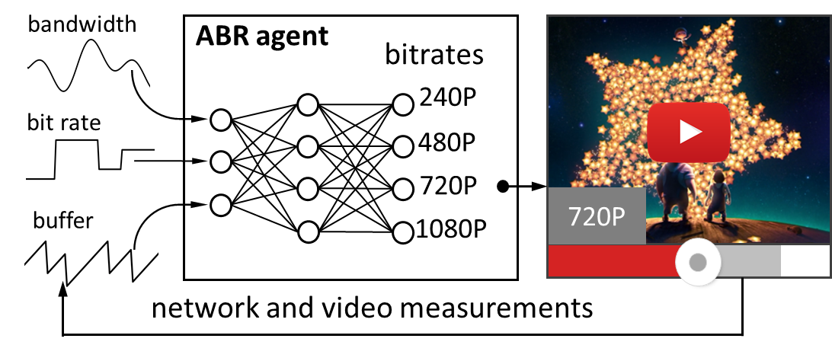
4
Delivery
PART
PART
PART
Challenge in mobile environment
Rule based algorithms
Reinforcement Learning（ RL ）based algorithms
Bitrate（next）as action
QoE as reward
bitrate（history）， buffer， bandwidth as environment
Neural Adaptive Video Streaming with Pensieve, SIGCOMM 2017
Notes:
为了避免提前对网络建模，一些研究提出了采用增强学习加人工神经网络的方法，解决视频传输中的码率自适应问题
简单的讲，强化学习就是让主体（Agent）通过观察环境（Environment），选择相应的动作（Action），每一个动作会对应使得主体进入一个新的状态（Status），同时获得相应的奖励（Reward），而期望解决的问题就是让主体选择获得的收益最大化的动作。
我们可以看出，码率自适应问题可以用增强学习的方法解决，我们需要解决的就是，如何选择视频的码率，是的在接下来的一段时间（比如到视频结束）所获得的整体的QoE达到最高，这里的QoE就是增强学习中的reward。

Slide 57
5
Example of Multimedia System
PART
PART
PART
Classes of Classical Multimedia System:
Streaming stored audio and video
Streaming live audio and video
Real-time interactive audio and video
Notes:
典型的传统多媒体系统应用

Slide 58



5
Example of Multimedia System
PART
PART
PART
Streaming stored audio and video
The multimedia content has been prerecorded and stored on a server.
User may pause, rewind, forward, etc.
The requests are asynchronous for the same video.
Notes:
1、点播系统事先将视频资源放置在服务器端，用户可以根据需求点播想要收看的视频，并进行暂停、前进、后退、等操作。
2、和直播平台以及实时会议系统不一样的是，不同用户访问资源的操作经常是异步的。
3、常见的点播平台有YouTube、 爱奇艺、优酷等。

Slide 59


5
Example of Multimedia System
PART
PART
PART
Streaming Live Audio and Video
Similar to traditional broadcast TV/radio, the multimedia content is real-time.
The interactions between users are text-based.
For the same program source, delay is inevitable at different user end.
Notes:
1、直播数据是实时产生的，
2、用户只能发送弹幕的方式进行交互。
3、相同内容的不同用户请求之间可能存在滞后
4、以个人为节目源的直播平台，twitch，斗鱼TV、等等。

Slide 60



5
Example of Multimedia System
PART
PART
PART
Real-Time Interactive Audio and Video
There is more than one real time multimedia sources during interactions.
The participant is both sender and receiver.
Different media sources must be played simultaneously.
Video Conferencing
Notes:
实时交互系统是用户双方在音频和视频上的双向的同步过程
对于延迟的要求较直播系统要高得多
典型的实时交互系统有视频会议 、QQ视频聊天、微信聊天等等

Slide 61
5
Example of Multimedia System
PART
PART
PART
SkyClass-a live multimedia e-Learning platform
Anytime, Anywhere, Anybody, Anydevice
Notes:
天地网模型

Slide 62
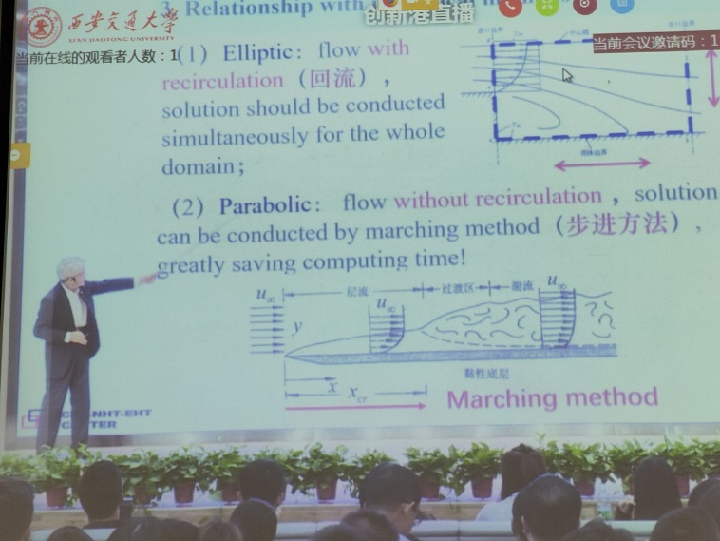



5
Example of Multimedia System
PART
PART
PART
SkyClass-a live multimedia e-Learning platform
Notes:
两个城市之间的教育资源共享
交大两个校区之间的教育资源共享

Slide 63
5
Example of Multimedia System
PART
PART
PART
Advanced Multimedia Applications:
Hardware Support
Higher Resolution
Efficient
Encoder/Decoder
More Immersive
High Speed
Transmission Network
Closer Collaboration
Notes:
以上技术发展的背景，使得未来的多媒体系统具有以下改进
更高的分辨率 例如，8K over 5G
沉浸感更强烈 例如，360°视频
联系更紧密，例如协作式交互

Slide 64




5
Example of Multimedia System
PART
PART
PART
Advanced Multimedia Applications:
Higher resolution---8K over 5G
Source
7680 x 4320 x 15 bit/pixel x 60fps
29.86 Gbps
Systematic support
Encoder
H.265 Main 10 Profile Level 6.1
85 Mbps
Delivery
Downlink bandwidth
400 Mbps
Decoder
Hardware support
e.g. GTX 1080ti
Notes:
以下是一些例子
超高清视频应用，需要系统化的支持
在视频源，能够采集8K视频
7680x4320分辨率， 15比特 YUV420采样，60fps帧率
7680 x 4320 x 15 bit/pixel x 60fps = 29.86 Gbps
在编码器层，将超高码率进行压缩，以便于进行传输
例如，采用H.265 Main 10 Profile Level 6.1编码，压缩为 85Mbps 码率
压缩率比高，编码和解码的计算代价越大
在传输层，需要5G等通信技术提供能够支持8K视频码率的链路带宽
在解码器层，需要硬件进行支持，当压缩比较高时，纯软件解码器很难实现稳定的解码效果

Slide 65

5
Example of Multimedia System
PART
PART
PART
Advanced Multimedia Applications:
More immersive --- 360° full view
Field of View (FoV) is limited.
How to efficiently deliver a 360° video?
Notes:
360°全景视频，一种根据有沉浸式的应用
随着用户的视角不同，展示的场景不同
可视区域FOV相对于整个360°场景是有限的
该如何传输360°视频以节省带宽？

Slide 66

5
Example of Multimedia System
PART
PART
PART
Advanced Multimedia Applications:
More immersive --- 360° full view
Adaptive Bitrate (ABR)
Higher Resolution
Lower Resolution
Notes:
基于HAS技术，FOV取高分辨版本，其余取低分辨率版本
通过行为预测等技术，在用户扭头使得FOV变化时，通过码率自适应调整不同区域的码率版本
提高新的FOV区域的码率

